Slide 1
Basic Electronics Engineering FE 2024 Course
Presented by
Mr. Aniruddha Nirmal
Assistant Professor
Department of First Year Engineering
DPCOE Pune

Slide 2
Unit IV : Operational Amplifier and Electronic Instruments
Syllabus
Electronic Instruments: Principles and block diagram of
Digital multimeter (DMM)
Function Generator (FG)
Digital Storage Oscilloscope (DSO)
AC/DC power supply
OP-AMP
OP-AMP Applications

Slide 3
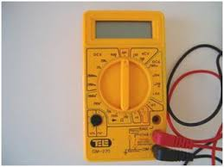
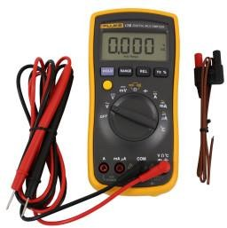
Digital Multimeter:
#What is Digital Multimeter (DMM)?
A digital multimeter is test equipment used for measurement of resistance, voltage, current and other electrical parameters as per requirement and displaying the results in the mathematical digits form on an LCD. It is a type of multimeter which functions digitally.
Digital multimeters are widely accepted worldwide as they have better accuracy levels and ranging from simple 3 ½ to 4 ½ digit handheld DMM to very special system DMM.

Slide 4

Digital Multimeter:
Constant Current Source
Buffer Amplifier
Resistance
AC attenuator
Rectifier Circuit
1
ACV
Rotary
Switch
2
Current to Voltage (I-V) Converter
(ADC)
Analog to Digital Converter
3
ACI
+
Input
Probes
4
5
DCI
Current to Voltage (I-V) Converter
DCV
DC attenuator
Digital Display
Fig. Block Diagram of Digital Multimeter

Slide 5
Digital Multimeter
#Working Principle of Digital Multimeter:
As shown in block diagram, in a typical Digital multimeter the input signal i.e. ac or dc voltage, current, resistance, temperature or any other parameter is converted to dc voltage within the range of the ADC.
The analog to digital converter then converts the pre-scaled dc voltage into its equivalent digital numbers which will be displayed on the display unit.
DMM is generally used for measurement of,
Voltage (AC or DC)
Current (AC or DC)
Resistance
In all above measurements analog to digital conversion is required to display the value on digital display.

Slide 6
Digital Multimeter
#Block diagram of DMM consists of,
ADC (Analog to Digital Converter) – heart of DMM – used to converts all measured analog values to digital values.
Attenuators (AC & DC) – for voltage measurements (function is opposite to amplifier)
Current to Voltage converter (AC & DC) - for current measurements
Constant current source – for resistance measurement
Buffer Amplifier – for high output impedance of the circuit
Rectifier circuit – converts AC to Pulsating DC.
Digital display– for display the measured value
Rotary switch – for selection of function or measurement.
#Features of Digital Multimeter:
It is light in weight.
Capable of giving more accurate readings.
It measures lots of physical quantities like voltage, current, resistance, frequency etc.
It is less costly.
It measures different electrical parameters at high frequencies with the help of special probes.

Slide 7
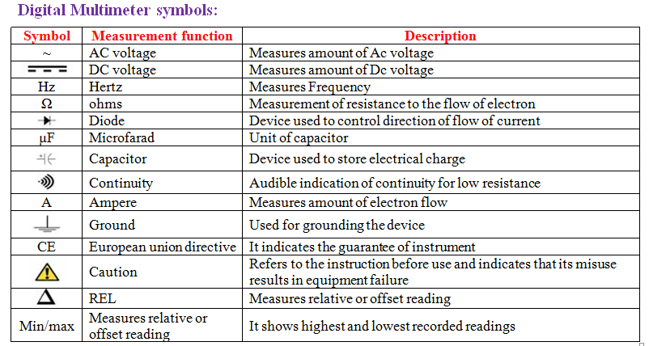
Digital Multimeter

Slide 8
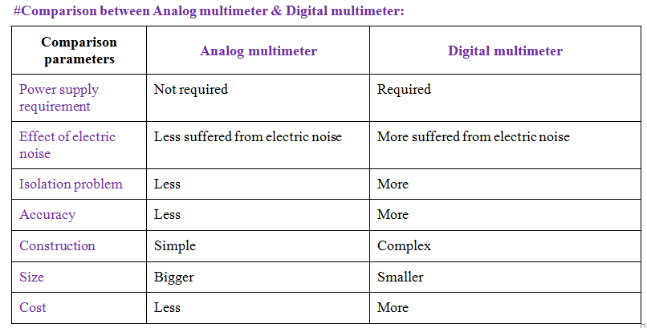
Analog & Digital Multimeter

Slide 9
Function Generator (FG)
Function: The function generator is signal generator which generates different types of waveforms.
A generator, which will produce periodic waves like triangular wave, square wave and sine wave is called Function generator.
There are two current sources, namely upper current source and lower current source in block diagram. These two current sources are regulated by the frequency-controlled network.

Slide 10
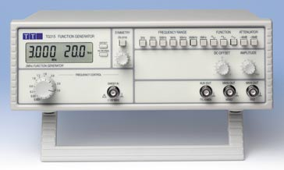
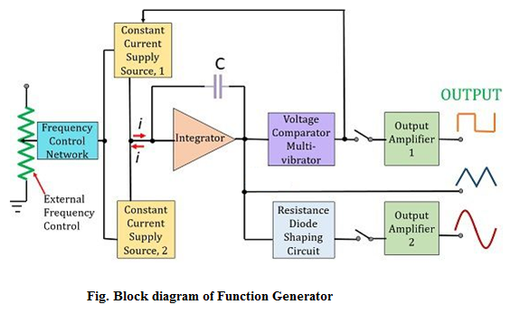
Function Generator (FG)

Slide 11
Function Generator (FG)
Triangular Wave
Integrator takes constant current alternately from upper and lowers current sources for equal amount of time repeatedly. So, the integrator will produce two types of output for the same time repeatedly −
The output voltage of an integrator increases linearly w.r.t. time for the period during which integrator gets current from upper current source.
The output voltage of an integrator decreases linearly w.r.t. time for the period during which integrator gets current from lower current source.
In this way, the integrator present in above block diagram will produce a triangular wave.

Slide 12
Function Generator (FG)
#Square Wave & Sine Wave
The output of integrator, i.e. the triangular wave is applied as an input to two other blocks in order to get the square wave and sine wave respectively.
Square Wave
The triangular wave has positive slope and negative slope alternately for equal amount of time repeatedly. So, the voltage comparator multi vibrator will produce the following two types of output for equal amount of time repeatedly.
One type of constant (higher) voltage at the output of voltage comparator multi vibrator for the period during which the voltage comparator multi vibrator gets the positive slope of the triangular wave.
Another type of constant (lower) voltage at the output of voltage comparator multi vibrator for the period during which the voltage comparator multi vibrator gets the negative slope of the triangular wave.
The voltage comparator multi vibrator will produce a square wave. If the amplitude of the square wave that is produced at the output of voltage comparator multi vibrator is not sufficient, then it can be amplified to the required value by using a square wave amplifier.

Slide 13
Function Generator (FG)
Sine Wave
The sine wave shaping circuit will produce a sine wave output from the triangular input wave. Basically, this circuit consists of a diode resistance network.
If the amplitude of the sine wave produced at the output of sine wave shaping circuit is insufficient, then it can be amplified to the required value by using sine wave amplifier.

Slide 14
Digital Storage Oscilloscope (DSO)
Oscilloscope is electronic equipment, which displays a voltage waveform.
Among the oscilloscopes, Digital Storage Oscilloscope (DSO) is special purpose oscilloscope.
The oscilloscope, which stores the waveform digitally, is known as digital storage oscilloscope.
Function: In DSO, the waveform to be stored is digitized, stored in a digital memory, and retrieved for display on the storage oscilloscope.

Slide 15

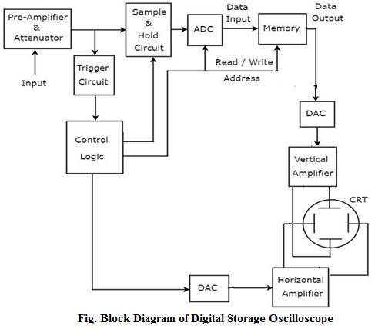
Digital Storage Oscilloscope (DSO)

Slide 16
Digital Storage Oscilloscope (DSO)
Block diagram of DSO:
Block diagram of a DSO consists of data acquisition, storage, and data display blocks. Digital storage oscilloscopes work in various modes.
The input signal is applied to the amplifier and attenuator section.
The oscilloscope uses same type of amplifier and attenuator circuitry as used in the conventional oscilloscopes.
The attenuated signal is then applied to the vertical amplifier.
To digitize the analog signal, analog to digital (A/D) converter is used
The output of the vertical amplifier is applied to the A/D converter section.
The successive approximation type of A/D converter is most often used in the digital storage oscilloscopes.
The sampling rate and memory size are selected depending upon the duration & the waveform to be recorded.
Once the input signal is sampled, the A/D converter digitizes it.
The signal is then captured in the memory.
Once it is stored in the memory, many manipulations are possible as memory can be readout without being erased.
The digital storage oscilloscope has three modes:
1. Roll mode – used to observe the fast carrying signals.
2. Store mode – commonly used mode. It is called refresh mode.
3. Hold or save mode .

Slide 17
Digital Storage Oscilloscope (DSO)
Advantages
i) It is easier to operate and has more capability.
ii) The storage time is infinite.
iii) The display flexibility is available. The number of traces that can be stored and recalled depends on the size of the memory.
iv) The cursor measurement is possible.
v) The characters can be displayed on screen along with the waveform which can indicate waveform information such as minimum, maximum, frequency, amplitude etc.
vi) The X-Y plots, B-H curve, P-V diagrams can be displayed.
viii) Keeping the records is possible by transmitting the data to computer system where the further processing is possible

Slide 18
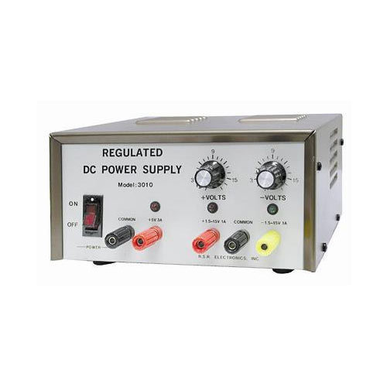





Regulated Power Supply
Transformer (Step-down)
Rectifier
Filter
(Decreases ripple)
Regulator
(Removes ripple)
Load
AC input
230V, 50Hz
AC to AC
(Step-down input)
AC to
Pulsating DC
Pulsating DC to
Unregulated DC
Unregulated DC to
Pure DC
Input to
Transformer
(A.C. voltage)
Output of Transformer
& Input to Rectifier
(Step down A.C. voltage)
Output of Rectifier
& Input to Filter
(Pulsating D.C. voltage)
Output of Filter
& Input to Regulator
(Unregulated D.C. voltage)
Output of Regulator
(Pure D.C. voltage)
Fig. Block diagram of Regulated Power Supply

Slide 19
Regulated Power Supply
The regulated power supply consists of,
Transformer
Rectifier
Filter
Regulator
The a.c. input voltage (i.e. 230V, 50Hz) is applied to the primary of transformer.
1. Transformer: (AC to AC converter)
Function: The transformer then steps-down the a.c. voltage, to the level needed for desired d.c. output. So, with suitable turns ratio we can get the desired a.c. secondary voltage.
2. Rectifier: (AC to pulsating DC)
Function: The rectifier circuit converts this a.c voltage into pulsating d.c. voltage. Pulsating d.c. voltage means unidirectional voltage. It contains large varying component called ripple in it.
3. Filter: (Decreases Ripple content)
Function: The filter circuit decreases the ripple content in pulsating d.c. and makes it smoother. The filter output still has some ripples. This voltage is called unregulated d.c. voltage.
4. Regulator: (Unregulated to Regulated (Pure) d.c.)
Function: A regulator makes the d.c. voltage smooth and free of ripples. It also keeps the d.c. voltage constant, though input d.c. voltage varies under some circumstances.The output of regulator is called d.c. voltage.
This d.c. voltage is connected to load.

Slide 20
Operational Amplifier
An operational amplifier (often op-amp or op-amp) is a DC coupled high-gain electronic voltage amplifier with a differential input and usually, a single-ended output
Op-amp is basically a multistage amplifier which is uses a number of amplifier stages interconnected to each other in a complicated manner.
The amplifier which could be configured to perform a variety of operations such as amplification, addition, subtraction, differentiation and integration.
Hence the name is operational amplifier (OP-AMP)
The integrated Op-amp offers all the advantages of monolithic integrated circuits such as small size, high reliability, reduced cost, less power consumption.
IC 741 is extremely popular and was used in a variety of applications.

Slide 21
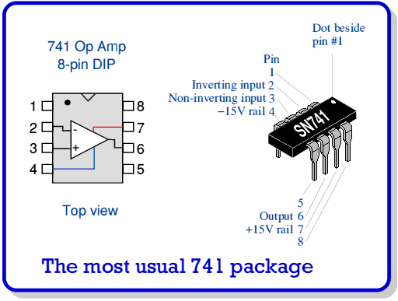
Pin configuration of OP-AMP IC 741

Slide 22
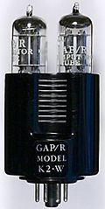
Symbol and terminal
+VCC positive supply voltage
Inverting input
2
741
-
7
6
Output
3
+
Non-Inverting input
4
-VEE negative supply voltage
The Operational Amplifier (op amp) was invented in the 40's. Bell Labs filed a patent in 1941 and many consider the first practical op amp to be the vacuum tube K2-W invented in 1952 by George Philbrick.

Slide 23
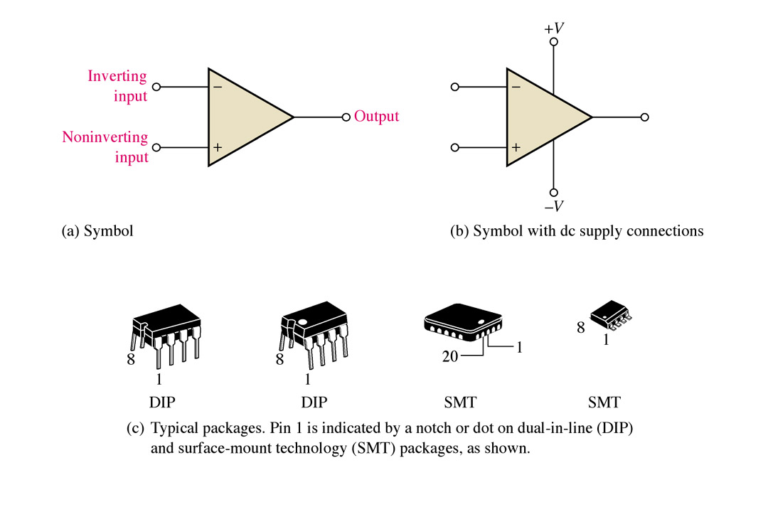
Op-amp symbols and packages.
Thomas L. Floyd Electronic Devices, 6e and Electronic Devices: Electron Flow Version, 4e

Slide 24
Ideal differential amplifier
An ideal differential amplifier is expected to amplify the differential signal present between its two input signal.
It is also the basic stage of an integrated Op-amp with differential input.
Ideal
Differential
Amplifier
Vd
+
Vo = V1 – V2
+
V1
V2
-
-

Slide 25
Ideal
Differential
Amplifier
Vd
+
Vo = V1 – V2
+
V1
V2
-
-
Differential gain -
Vo = Ad ( V1 – V2 )
Where Ad is called as the differential gain.
The differential gain can be defined as the gain with which the differential amplifier amplifies the differential signal.
Vo = Ad Vd as Vd = V1 – V2
Gain Ad = Vo / Vd
Ad (dB) =10 log₁₀ [ Vo / Vd ]

Slide 26
Ideal
Differential
Amplifier
Vd
+
Vo = V1 – V2
+
V1
V2
-
-
Common mode signal
A common signal to both the input terminals ( i.e. V1=V2=V) is called as common mode signal.
The output voltage produced by an ideal differential amplifier is zero for the common mode signal.

Slide 27
Block diagram of a typical OP-AMP
Non-inverting
input
+
Input
Stage
Intermediate
stage
Level
shifting
stage
Output
Stage
Output
Inverting
input
-
Dual input
Balanced
Output
Differential
amplifier
Dual input
unbalanced
Output
Differential
amplifier
Such as
Emitter follower
Using constant
Current source
Complementary
Symmetry
Push-pull
amplifier

Slide 28
Input and output signals 180⁰ phase shift when the input signal is applied to the inverting (-) terminal
+VCC
input
Inverting input
2
741
-
7
6
Vo
3
+
4
Inverted Output signal
-VEE

Slide 29
Input and output signals 0⁰ phase shift when the input signal is applied to the Non-inverting (+) terminal
+VCC
2
741
-
7
6
Vo
3
+
4
input
Non-Inverting
input
Non-Inverted Output signal
-VEE

Slide 30
Ideal
Differential
Amplifier
Vd
+
Vo = V1 – V2
+
V1
V2
-
-
Common mode rejection ratio (CMRR)
Common mode rejection ration (CMRR) is the ability of a differential amplifier to reject the common mode signal successfully.
CMRR is defined as the ratio of differential gain Ad and common mode gain Ac. It is denoted by letter “ρ”
CMRR = ρ = Ad / Ac
Ideally CMRR should be infinite and practically it should be as high as possible.

Slide 31
Equivalent circuit of an OP-AMP
+ VCC
Inverting input
-
R_{o}
Output
V_{d}
R_{i}
+
+
A_{V}V_{d}
+
V_{o}
R_{L}
-
Non-Inverting input
-
-VEE

Slide 32
The ideal OP-AMP
8
R_{i}
I_{B2}= 0
V2
-
R_{o}
0
Zero differential
Input voltage
R_{o}
Output
V_{d}= 0
R_{i}
Vo = A_{V}V_{D}
+
A_{V}V_{d}
+
V1
-
A_{V}
8
I_{B1}= 0
Important characteristics of Op-Amp
Infinite voltage gain ( )
the open loop gain of an ideal OP-AMP is denoted by Av. It is the
differential voltage gain and its value for an ideal OP-AMP is infinite.
A_{V}
8
Vo = A_{V}V_{D}

Slide 33
The ideal OP-AMP
R_{i}
8
I_{B2}= 0
V2
-
R_{o}
0
Zero differential
Input voltage
R_{o}
Output
V_{d}= 0
R_{i}
Vo = A_{V}V_{D}
+
A_{V}V_{d}
+
V1
-
A_{V}
8
I_{B1}= 0
2. Infinite input resistance (R_{i ➔} ∞)
the input resistance Ri of an ideal OP-amp is infinite. Due to this,
the current flowing in each input terminal will be zero.
due to infinite input resistance, almost any source can drive it and there is no loading of the source.
I_{B1}= 0
I_{B2}= 0

Slide 34
The ideal OP-AMP
R_{i}
8
I_{B2}= 0
V2
-
R_{o}
0
Zero differential
Input voltage
R_{o}
Output
V_{d}= 0
R_{i}
Vo = A_{V}V_{D}
+
A_{V}V_{d}
+
V1
-
A_{V}
8
I_{B1}= 0
3. Zero output resistance ( = )
the output resistance Ro of an ideal OP-amp is zero. Due to this,
the ideal Op-amp can handle infinite number of other devices.
R_{O}
0

Slide 35
The ideal OP-AMP
R_{i}
8
I_{B2}= 0
V2
-
R_{o}
0
Zero differential
Input voltage
R_{o}
Output
V_{d}= 0
R_{i}
Vo = A_{V}V_{D}
+
A_{V}V_{d}
+
V1
-
A_{V}
8
I_{B1}= 0
4. Zero offset voltage
in practical Op-amps a small output voltage is present even though
both the inputs V1 ad V2 are having a zero value.
This voltage is called as the offset voltage.
for ideal Op-amp the offset voltage is zero.
That means output voltage is zero when input voltage is zero.

Slide 36
The ideal OP-AMP
R_{i}
8
I_{B2}= 0
V2
-
R_{o}
0
Zero differential
Input voltage
R_{o}
Output
V_{d}= 0
R_{i}
Vo = A_{V}V_{D}
+
A_{V}V_{D}
+
V1
-
A_{V}
8
I_{B1}= 0
5. Infinite Bandwidth
Bandwidth of an amplifier is the range of frequencies over which all
the signal frequencies are amplified almost equally.
The bandwidth of an ideal Op-amp is infinite. So it can amplify any
frequency from zero to infinite hertz.
Thus the gain of an ideal amplifier is constant from zero to infinite hertz.

Slide 37
The ideal OP-AMP
R_{i}
8
I_{B2}= 0
V2
-
R_{o}
0
Zero differential
Input voltage
R_{o}
Output
V_{d}= 0
R_{i}
Vo = A_{V}V_{D}
+
A_{V}V_{D}
+
V1
-
A_{V}
8
I_{B1}= 0
6. Infinite CMRR
for an Op-amp, the common mode rejection ratio (CMRR) id defined
as the ratio of differential gain to common mode gain.
CMRR is infinite for the ideal Op-amp.
Thus the output voltage corresponding to the common mode noise is zero.

Slide 38
The ideal OP-AMP
R_{i}
8
I_{B2}= 0
V2
-
R_{o}
0
Zero differential
Input voltage
R_{o}
Output
V_{d}= 0
R_{i}
Vo = A_{V}V_{D}
+
A_{V}V_{D}
+
V1
-
A_{V}
8
I_{B1}= 0
7. Infinite slew rate
the slew rate of an ideal Op-amp is infinite so that the output voltage
changes occur simultaneously with the input voltage changes.

Slide 39
The ideal OP-AMP
R_{i}
8
I_{B2}= 0
V2
-
R_{o}
0
Zero differential
Input voltage
R_{o}
Output
V_{d}= 0
R_{i}
Vo = A_{V}V_{D}
+
A_{V}V_{D}
+
V1
-
A_{V}
8
I_{B1}= 0
8. Zero power supply rejection ratio (PSRR).
PSSR is a parameter which specifies the degree of the dependence
of the Op-amp output on the changes in power supply output. For an
ideal Op-amp, PSRR = 0. that means the output voltage does not
Change due to fluctuation in supply voltage

Slide 40
Important characteristics of OP-AMP IC 741
Sr. No. | Characteristics | Value for IC 741 | Ideal value
1 | Input resistance Ri | 2 MΩ
2 | Output resistance Ro | 75 Ω | 0
3 | Voltage gain Av | 2 X 10⁵
4 | Bandwidth BW | 1 MHz
5 | CMRR | 90 dB
6 | Slew rate S | 0.5 V/μS
7 | Input offset voltage | 2 mV | 0
8 | PSRR | 150 μV/V | 0
9 | Input bias current | 50 nA | 0
10 | Input offset current | 6 nA | 0
8
8
8
8
8

Slide 41
Open loop configuration of OP-AMP
The meaning of open loop operation is that there is absolutely no feedback present from the output to input.
Vo = Av Vd
+V_{(SAT)}
Op amp
-
Vd
a
b
0
Vd
+
Vo = Av Vd
V1
+
+
V2
-V_{(SAT)}
-
-

Slide 42
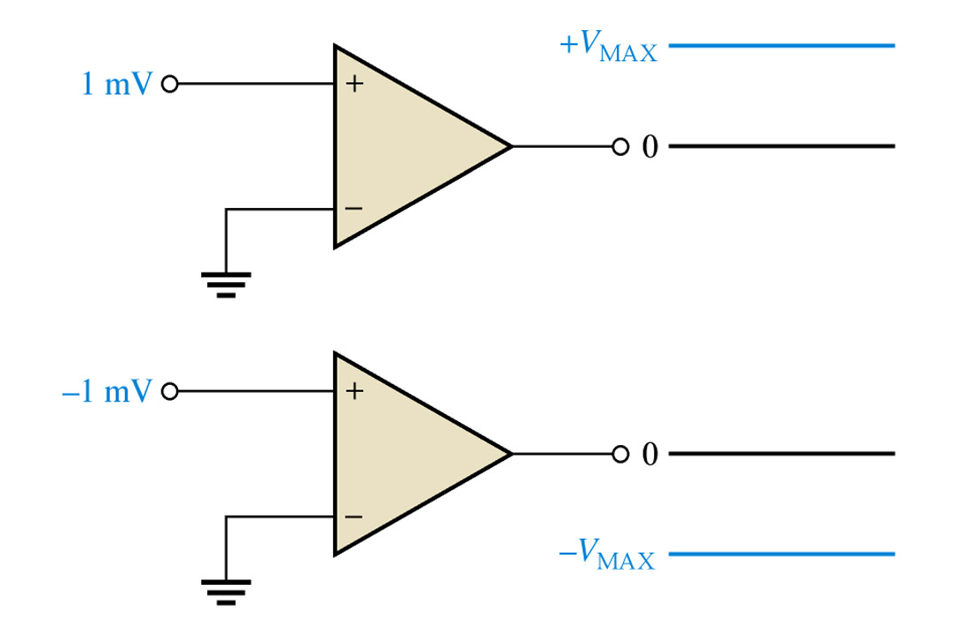
Open loop configuration of OP-AMP

Slide 43
Why Op-amp not used as an amplifier in the open loop configuration ?
Due to very large open loop gain, distortion is introduced in the amplified output signal.
The open loop gain does not remain constant, it varies with change in temperature and power supply.
The bandwidth of an Op amp in open loop mode is very very small – almost zero
For this reason the Op-amp is not used in practice as an amplifier.
However the Op-amp in open loop configuration is used in application such as comparator.

Slide 44
Close loop configuration of OP-AMP
In the closed loop configuration some kind of “feedback” is introduced in the circuit.
A part of output is returned back or fed back to the input.
Types of feedback
Positive feedback or Regenerative feedback
Negative feedback or Degenerative feedback.

Slide 45
Positive feedback or regenerative feedback
If the feedback signal and the original input signal are in phase with each other then it is called as the positive feedback.
Positive feedback is used in the application such as “Oscillators” and Schmitt triggers or regenerative comparators.

Slide 46
Negative feedback or Degenerative feedback
If the signal is fed back to the input and the original input signal are 180⁰ out of phase, then it is called as the negative feedback.
In the application of Op-amp as an amplifier, the negative feedback is used.

Slide 47
Negative feedback or Degenerative feedback
In the amplifier circuits using Op-amp, a feedback resistor RF is connected between the output and inverting terminal as shown in figure to introduced a negative feedback.
As the voltages V₂ and V_{O} are 180⁰ out of phase, a fraction of output voltage fed back to the input via R_{F} will be 180⁰ out of phase with the input.
R_{F}
Feedback resistor
input
V₂
2
Output
OP-AMP
-
6
V_{o}
V₁
3
+

Slide 48
Advantages of Negative feedback
Negative feedback is used in the amplifier circuits as they provide the following improvements in the operation of an amplifier:
It stabilizes the gain.
Reduces the distortion.
Increases the bandwidth.
Changes the values of input and output resistances.
Reduces the effects of variation in temperature and supply voltage on the output of the Op-amp.

Slide 49
Virtual short
R_{i}
8
+VCC
I = 0
V2
-
R_{i}
Output
V_{d}
Vo = A_{V}V_{D}
+
V1
-VEE
The input impedance Ri of an Op-amp is ideally infinite.
Hence current “I” flowing from one input terminal to the other will be zero. Thus the voltage drop across Ri will be zero and both the input terminals will be at same potential, in other words they are virtually shorted to each other.

Slide 50
The Inverting Amplifier
+
-
input
R_{F}
V_{S}
I
t
V₂
0
-
+
-
OP-AMP
R₁
I_{B2} = 0
V_{S}
+
V_{d}
V_{O}
V_{o}
V₁
+
8
A_{V} =
0
t
-
Expression for the closed loop voltage gain (A_{VF})
A_{VF} = - R_{F} / R₁
The negative sign indicates that there is a phase shift of 180⁰
Between the input and output voltages.

Slide 51
The Non-Inverting Amplifier
-
+
-
+
R₁
R_{F}
input
V₂
V_{S}
-
OP-AMP
t
I₂ = 0
0
I₁ = 0
V_{o}
V₁
+
8
A_{V} =
V_{O}
+
V_{S}
t
0
-
As input impedance of ideal Op-amp is infinite, the current entering into both the input terminals of
Op-amp will have zero values. (I₁ = I₂ = 0 )

Slide 52
The Voltage follower (unity gain buffer)
-
+
-
+
R_{F} = 0
8
R₁ =
V₂
-
OP-AMP
I₂ = 0
I₁ = 0
V_{o}
V₁
+
8
A_{V} =
+
V_{S}
-
When R1 is infinite and RF = 0 the non-inverting amplifier gets converted into a voltage follower or unity gain.

Slide 53
THANK YOU

